Slide 1
VISUALIZATION, ANALYSIS, AND FORECASTING OF ENERGY CONSUMPTION USING SMART HOME DATA
By Tarun John

Slide 2
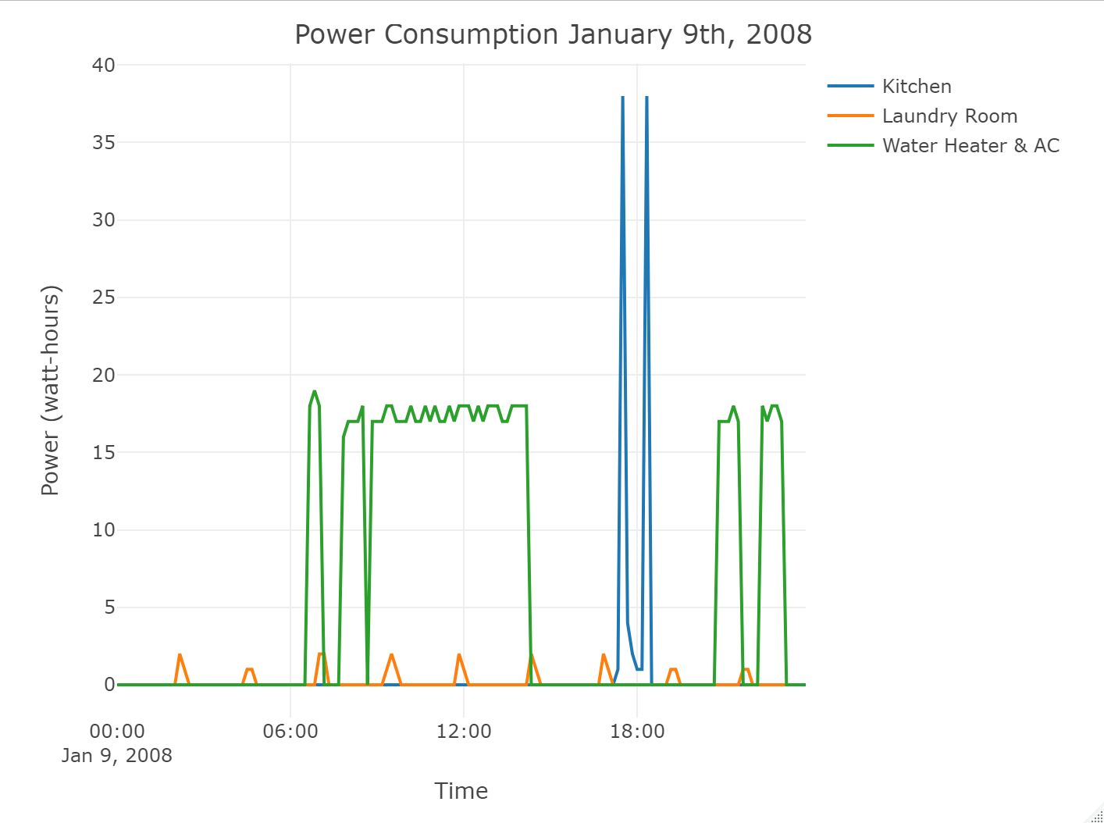
Power consumption for a selected day

Slide 3
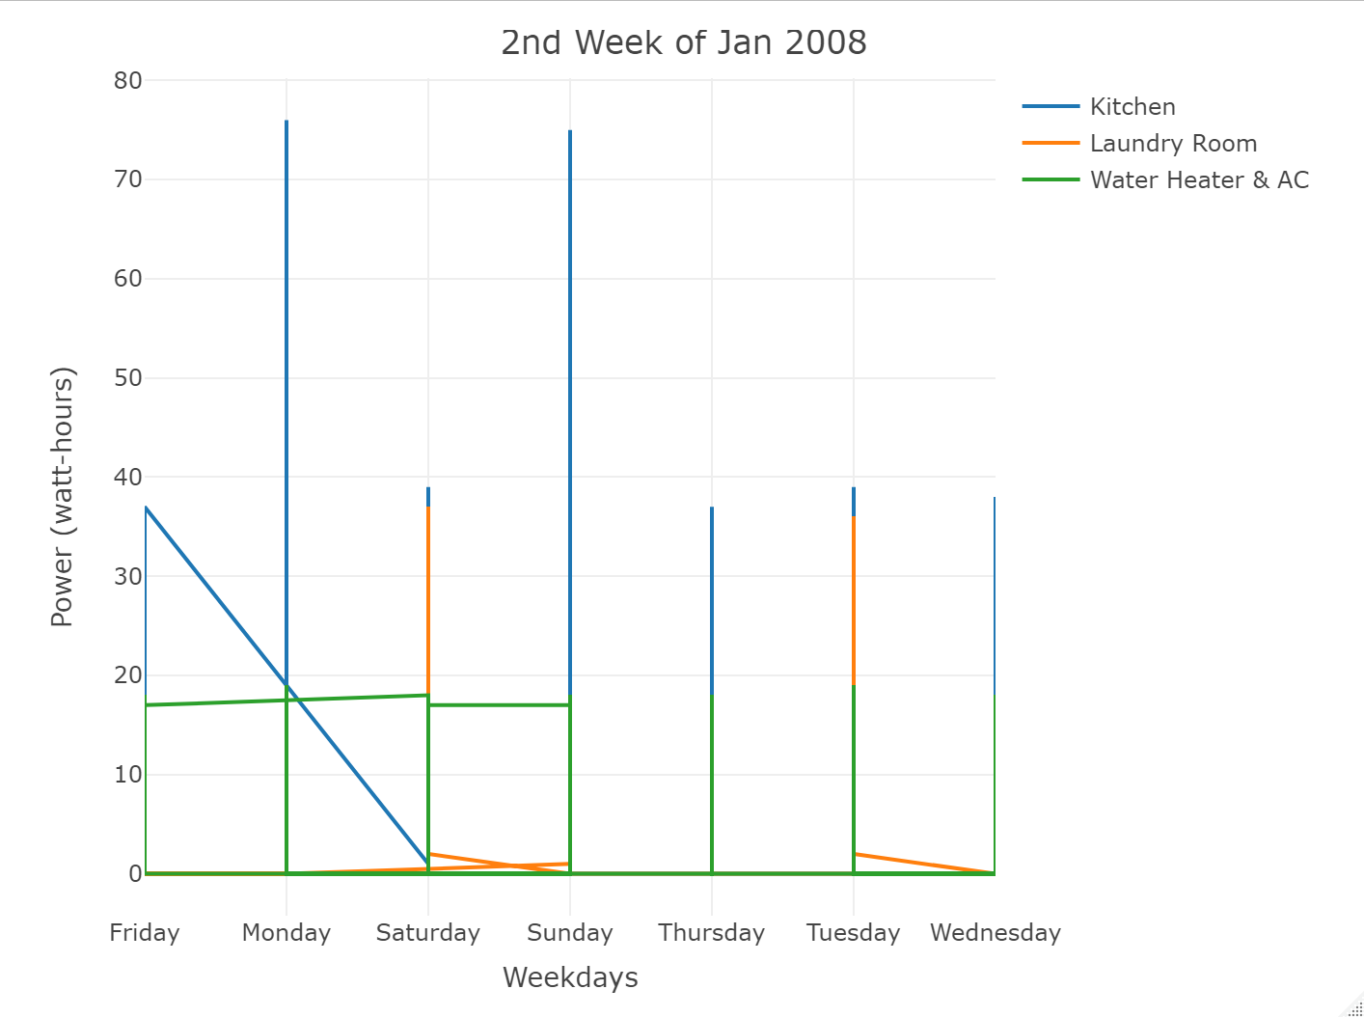
Power consumption for a selected week

Slide 4
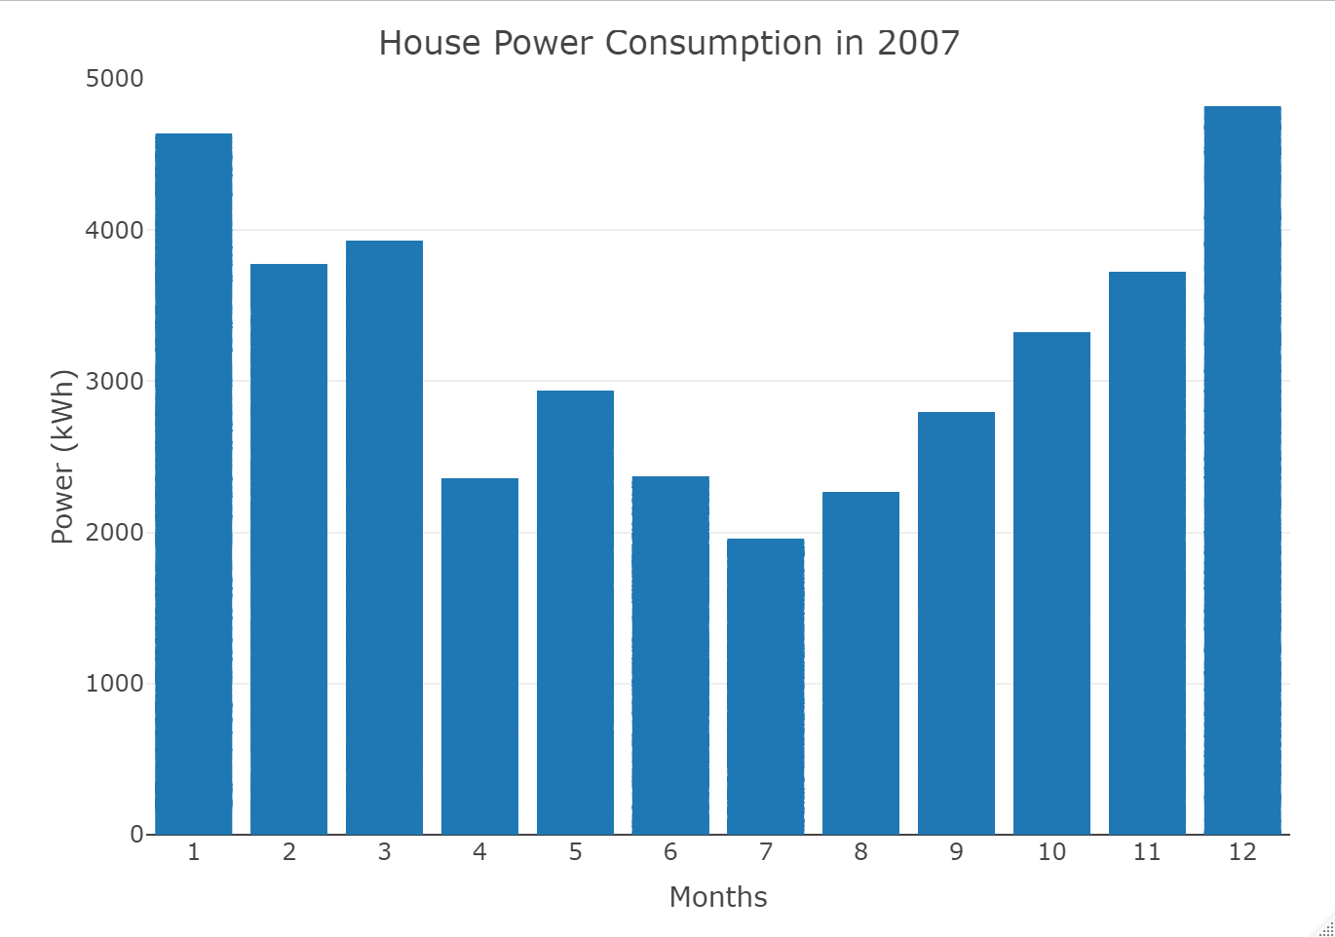
Power consumption for a selected year

Slide 5
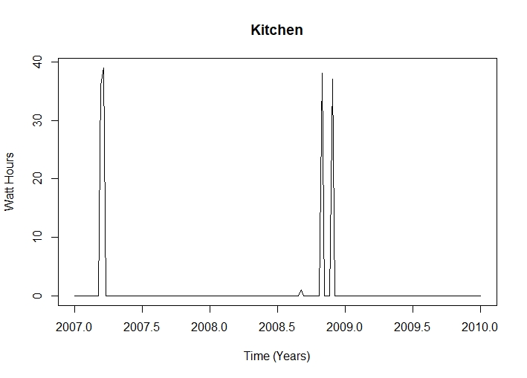
Time series analysis of meter 1

Slide 6
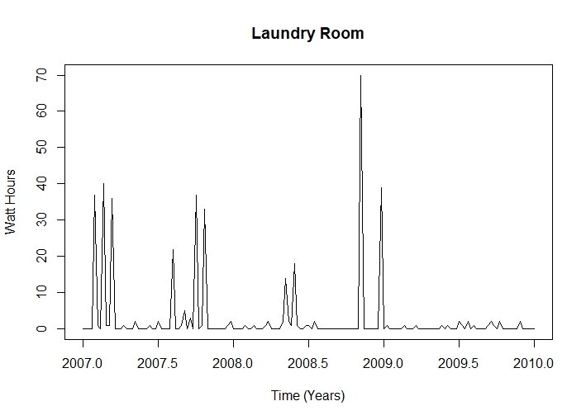
Time series analysis of meter 2

Slide 7
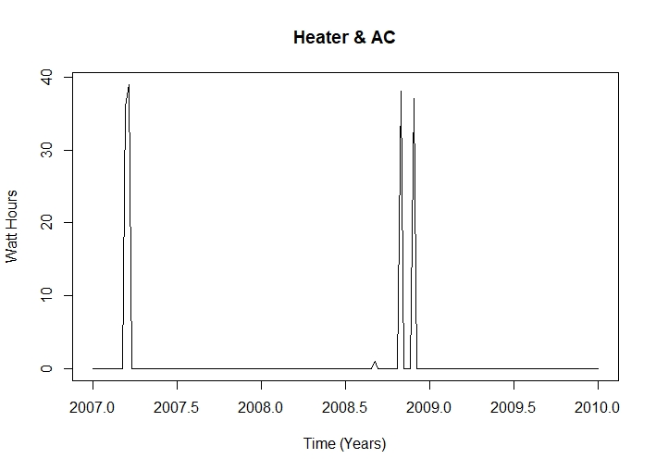
Time series analysis of meter 3

Slide 8
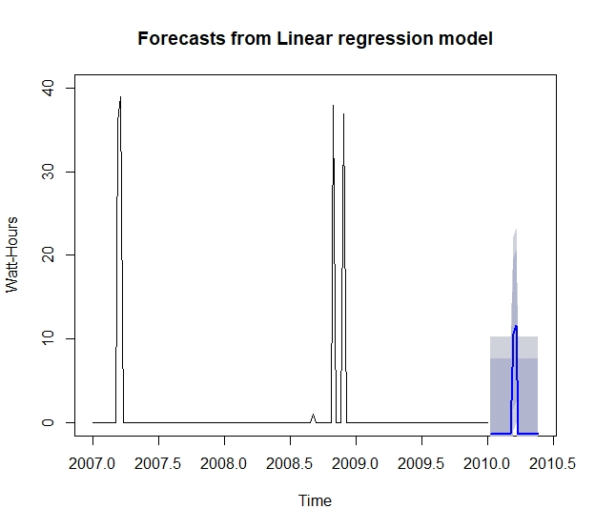
Linear regression forecast meter 1

Slide 9
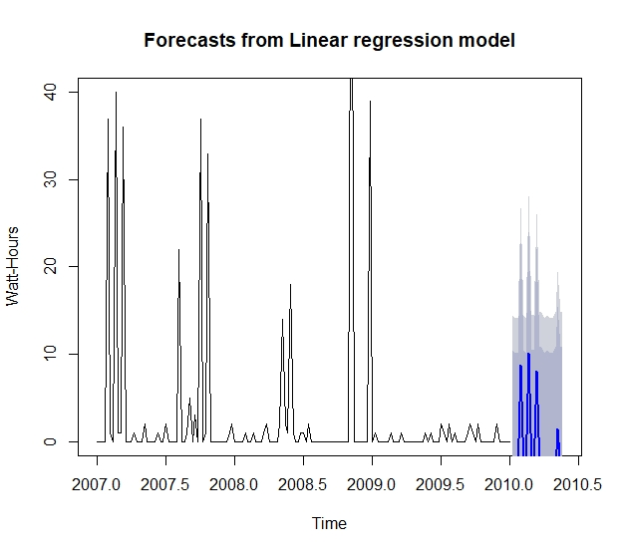
Linear regression forecast meter 2

Slide 10
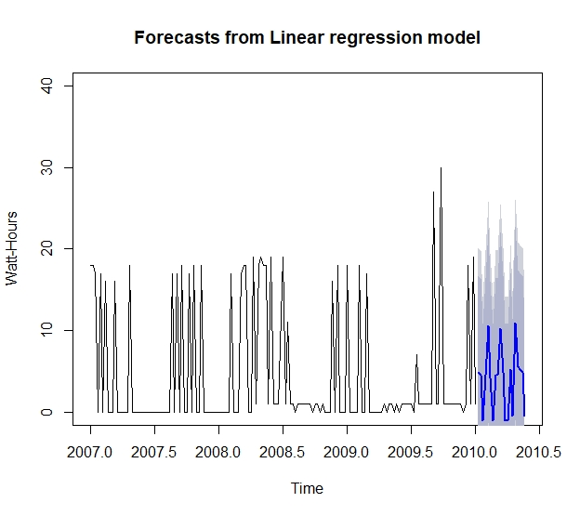
Linear regression forecast meter 3

Slide 11
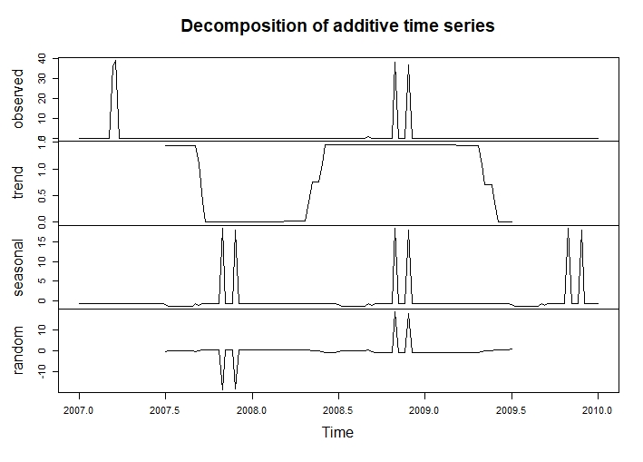
Decomposition visualization meter 1

Slide 12
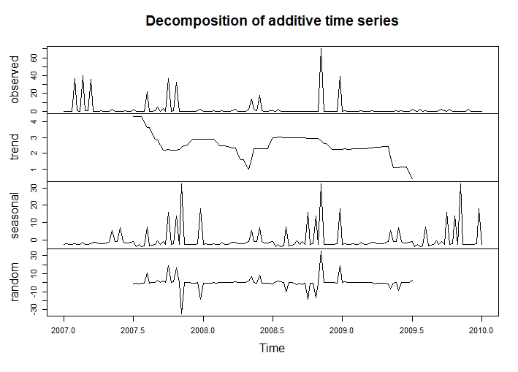
Decomposition visualization meter 2

Slide 13
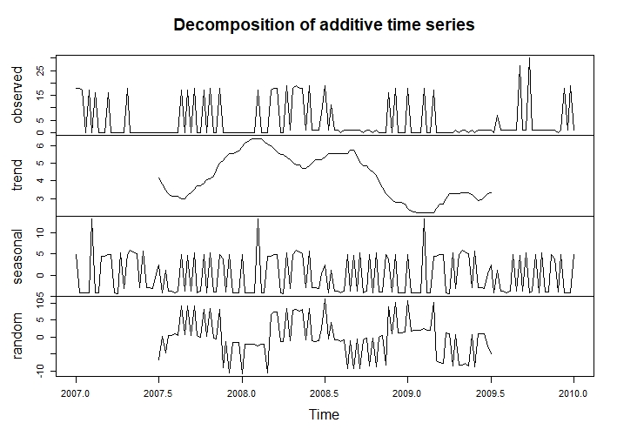
Decomposition visualization meter 3

Slide 14
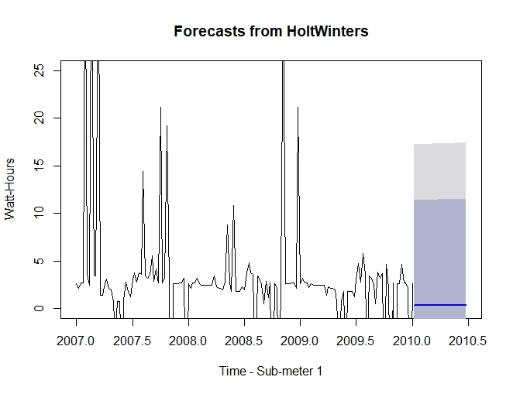
Holt-Winters Forecasting meter 1

Slide 15
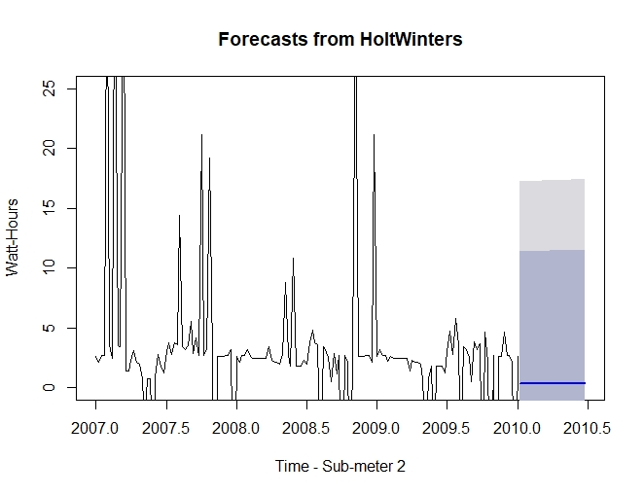
Holt-Winters Forecasting meter 2

Slide 16
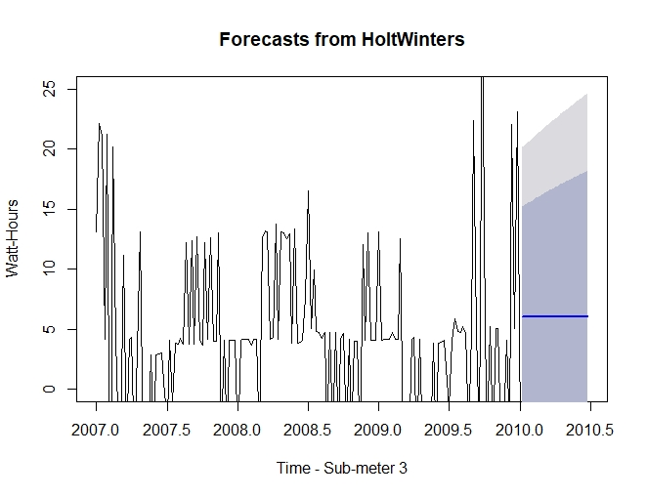
Holt-Winters Forecasting meter 3

Slide 17
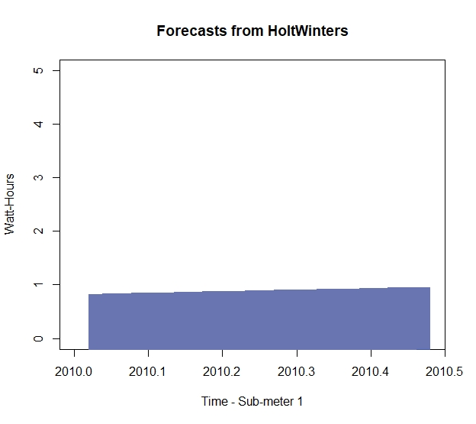
Holt-Winters Forecasting-only meter 1

Slide 18
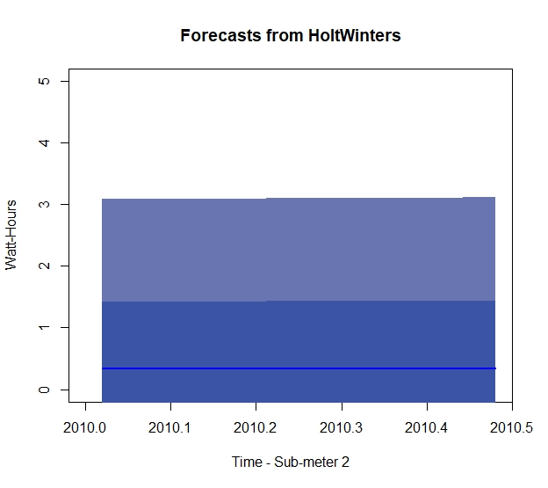
Holt-Winters Forecasting-only meter 2

Slide 19
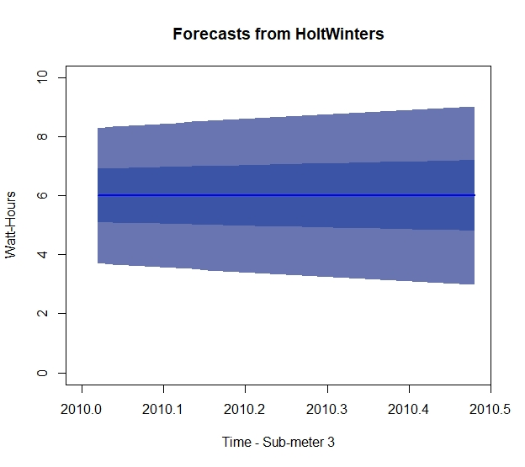
Holt-Winters Forecasting-only meter 3

Slide 20
Suggestions & patterns
There is a pattern of kitchen use around 6 pm.
There is a pattern of heater or A/C use around early morning and evening.
There is a pattern of higher household electricity use during winter months.
Due to these patterns it is recommended that insulation of the housing be increased to reduce thermal wasting.

